Slide 1
G. E. A. R. S.
Growing Educators,
Achieving Results with Students
June 14, 2017

Slide 2
Mission
In Avondale, every student will grow as a thinker, problem solver and communicator to pursue a future without limits.

Slide 3
Affirming our Beliefs
We believe all children are capable of success – No exceptions.
We connect all children to caring adults to reveal and grow the possibilities.
We prepare students for their future by time traveling to allow children to see their potential in four destinations and to plan for it today. We are a district of Hope.

Slide 4

GEARS
Growing Educators, Achieving Results with Students

Slide 5


Maintaining active engagement for all learners
Lesson Planning for the Success of Each Student
Creating an Environment for Learning
Helping Students Develop
Understanding
LEARNING TARGET
Helping Students Extend and Apply Knowledge
wordle.net
tagxedo.com
Prepared for the GEARS Team Members of
Avondale Elementary School District
by Dan Mulligan, Ed. D., flexiblecreativity.com (Twitter: @drdanmulligan)
June 2017
“The difference between who you are and what you want to be is what you do.” ~Bill Phillips,2006

Slide 6
Opportunities – Checking for Understanding
Tell your neighbor, what might happen next in the story and what makes you think that or what is your best estimate and how you arrived at that number…
Communicators
Thinkers
Current Research from McREL reveals, on average, students can listen without’ doing something’ with the information for 2.5 to 3 minutes.
During this checking for understanding phase is to listen, offer clarifying and 2nd questions to probe deeper, and then respond accordingly.
Problem
Solvers

Slide 7
4 - second
partner

Slide 8
Creating an Environment for Learning
Setting Objectives
and
Providing Feedback
Unpacking the Standard
Key elements of the lesson planning process
Celebrating You!
Work collaboratively (e.g., construct viable arguments, critique, agree) to identify key elements of the lesson planning process.
Enjoy working with your new best friend.

Slide 9


Slide 10
Today’s Goal
Today I will actively participate in sharing with and learning from peers…
So I can purposefully increase my own ability to apply new district lesson planning resources
I’ll know I will have it when I collaboratively create a research-based lesson.
Critical Vocabulary
Checking 4 understanding
Fluency
Process Standards
Application Problem
Facilitating versus telling
Conceptual Development
Closure

Slide 11
Lesson
Flowchart
Clear Objective (Today I will…)/Vocabulary
referenced by teacher/students throughout learning
Creating an Environment for Learning
Provides students with context
Allows teacher to build/check for background knowledge
Integration of:
Constant checks for understanding of each student..
Seize opportunities for student collaboration on second questions!
Helping Students Develop Understanding
This is the teaching/learning/discovering phase. Multiple checks for understanding along the way. Modeling, Guided Practice, Independent Practice
Helping Students Extend & Apply Knowledge
Student reflection & doing something with what they learned.

Slide 12


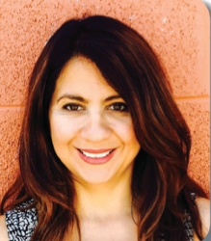
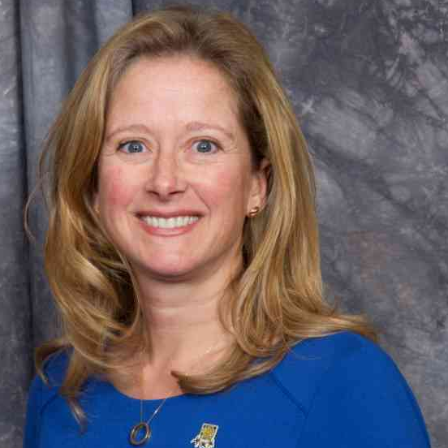

Organizing Theme:
Things someone would say…
EDUCATIONAL
STAKEHOLDER EDITION
Bus Driver
Triangle
Trivia
200 POINTS
Parent
Student
100 POINTS 100 POINTS
Principal
Superintendent
Teacher
50 POINTS 50 POINTS 50 POINTS

Slide 13
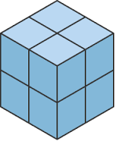

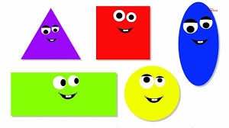
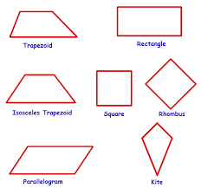


Geometry
Volume
200 POINTS
Equilateral
Plane
100 POINTS 100 POINTS
Quadrilateral
Rectangle
Sphere
50 POINTS 50 POINTS 50 POINTS

Slide 14
Higher-Order
Student
Thinking
Predict
200 POINTS
Justify
Innovate
100 POINTS 100 POINTS
Compare
Sequence
Explain
50 POINTS 50 POINTS 50 POINTS

Slide 15
4 – second partner
Discuss with your new partner, the elements of lesson planning process that you or your former partner shared earlier.

Slide 16
Lesson
Flowchart
Clear Objective (Today I will…)/Vocabulary
referenced by teacher/students throughout learning
Creating an Environment for Learning
Provides students with context
Allows teacher to build/check for background knowledge
Integration of:
Constant checks for understanding of each student..
Seize opportunities for student collaboration on second questions!
Helping Students Develop Understanding
This is the teaching/learning/discovering phase. Multiple checks for understanding along the way. Modeling, Guided Practice, Independent Practice
Helping Students Extend & Apply Knowledge
Student reflection & doing something with what they learned.

Slide 19
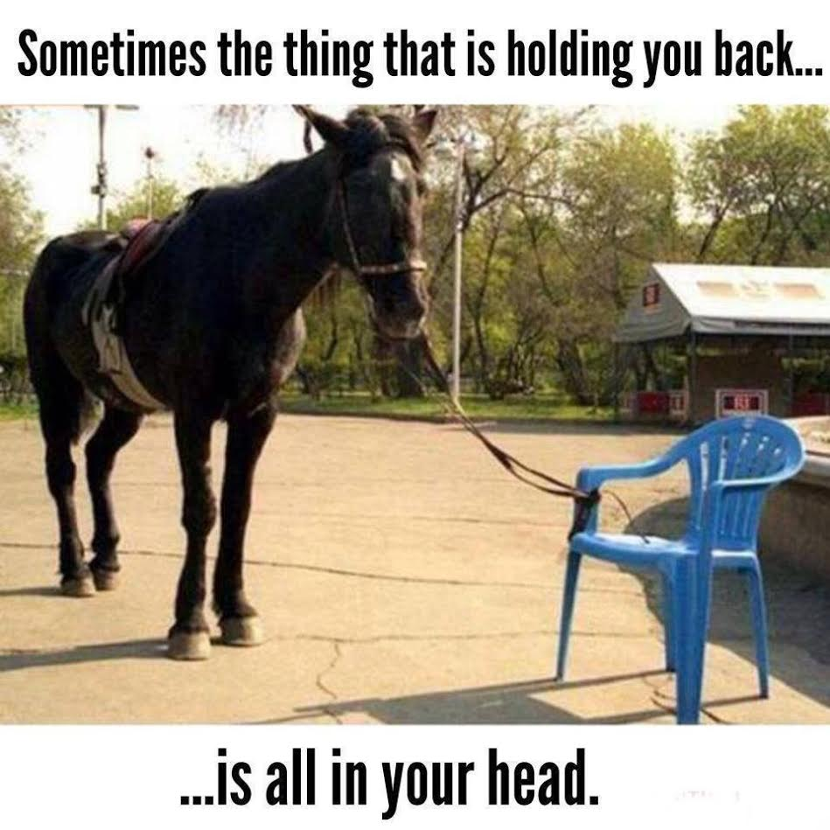
Research-Based Lesson Design
Fluency
Opening/ Application Problem
Concept Development
Closure
Debrief
Creating an Environment for Learning
Helping Students Develop Understanding
Helping Students Extend and Apply Knowledge

Slide 20
Content Neutral Structure:
BLIND SEQUENCING
Directions:
Deal the cards facedown to each team member.
You may look at your card(s) but not allow else to see your card(s).
The team member seated clockwise next to the dealer should describe the lesson component on a card. Others may ask questions. Place card facedown on the table.
Then the next team member will describe the lesson component on one of their cards.
The team must sequence the cards without looking until all cards are down.
MODELED WITH THE AVONDALE
MATH LESSON GUIDE

Slide 22
Sequencing the Guaranteed & Viable Curriculum

Slide 23
Clarifying the Guaranteed & Viable Curriculum

Slide 24
Math Process Standards

Slide 25
Resources to Support a
Guaranteed & Viable Curriculum

Slide 26

Thank you for your commitment to children!
"It's your attitude, not just your aptitude that determines your ultimate altitude."
--Zig Ziglar ☺
Dan

